Slide 1
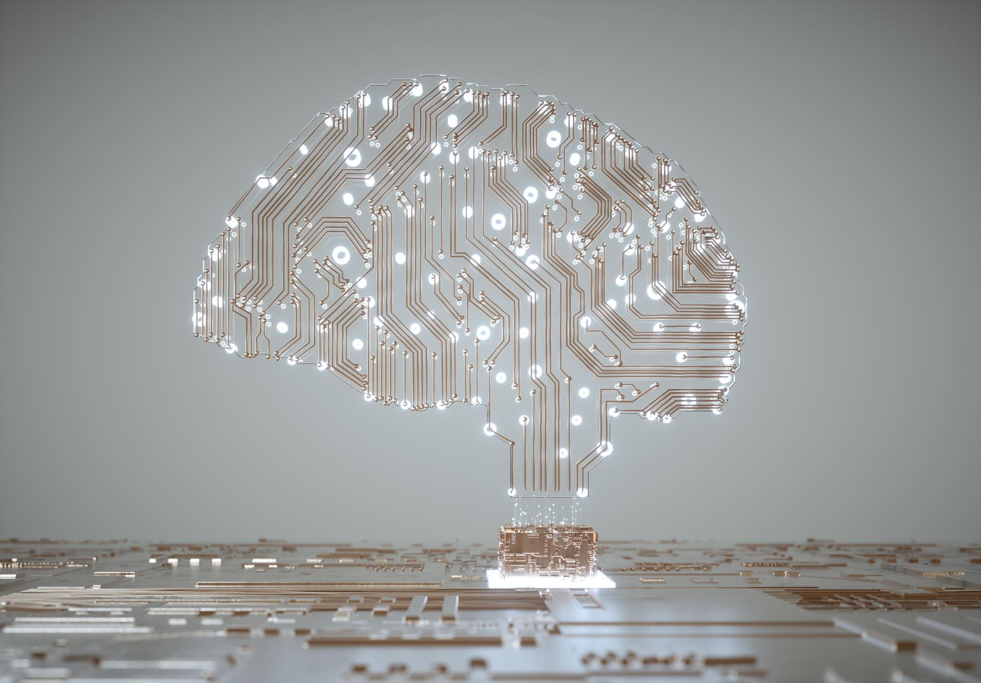
Artificial Intelligence From ChatGPT to Autonomous Agents and Multimodal Possibilities
Dr. Raymond Uzwyshyn Associate Dean, Collections Management and Strategy Mississippi State University Libraries, 2024

Slide 2
AI Histories
1950’s
Begins in the 1950’s, mostly US and Britain. Main Figures, Alan Turing (Turing Test), John McCarthy Dartmouth Conference (Artificial Intelligence name is coined), Marvin Minsky
1960’s
Continues in 1960’s Josef Weizenbaum (Eliza, First Chatbot), Marvin Minsky, Neural Nets Introduced (processing power issues)
1980’s -1990’s
AI winter, Expert Systems, IBM’s Deep Blue (1997) beats Kasparov in Chess
1990’s-2000’s
(Geoffrey Hinton, U Toronto), Push Singh (MIT), Chris Mckinstry, Deb Roy (Waterloo, MIT, Early Voice Recognition)
2010’s
Deep Learning/Neural Net Renaissance Ilya Sutskevar (U Toronto, AlexNet, Images), Yoshua Benjio, Yann LeCun Google Deep Mind (Demis Hassabis, Cambridge, UC London, Deep Mind/Google, Lee Sedol, Alpha Go)

Slide 3
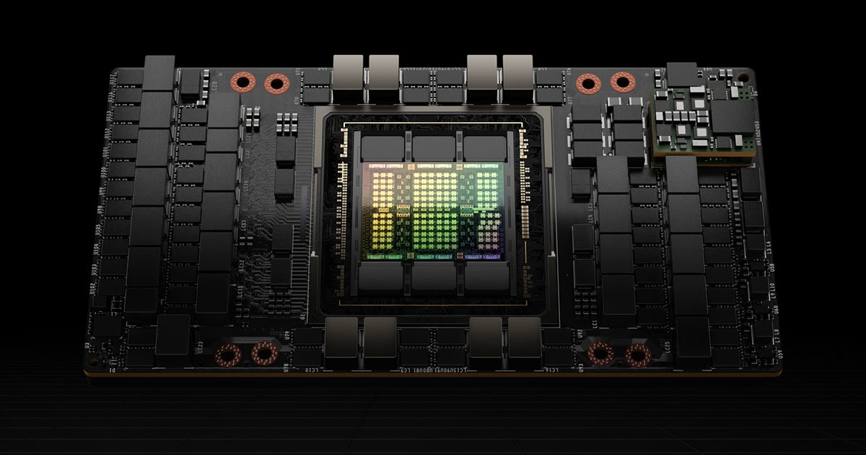
Moore’s Law, (Processing Power and AI) Number of Transistors on an Integrated Circuits Doubles Every 2 years
NVIDIA A/H100
5000, 000, 000 Transistors (2014)
Deep Blue/Kasparov 5000,000 Transistors (1997)
Eliza: Mainframe and Terminal 50,000 Transistors (1982)
5000 Transistors (1970)

Slide 4
Data Storage, Memory and AI Cost/TB (AI Requires Massive Datasets For Training Neural Nets)
1 Byte = 0.001 Kilobytes (KB)
1 Kilobyte (KB) = 1 KB
1 Megabyte (MB) = 1,000 KB
1 Gigabyte (GB) = 1,000,000 KB
1 Terabyte (TB) = 1,000,000,000 KB (1 Billion KB, Trillion Bytes
1 Petabyte (PB) = 1,000,000,000,000 KB
1 Exabyte (EB) = 1,000,000,000,000,000 KB
1 TB (2024) = 50.00-100.00 USD (Hard Drive or Cloud)

Slide 5
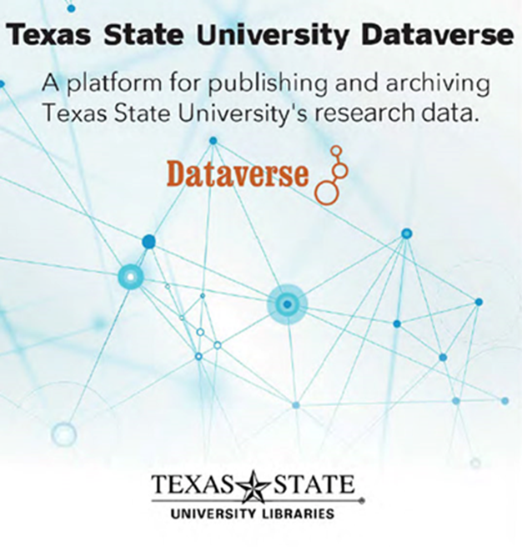
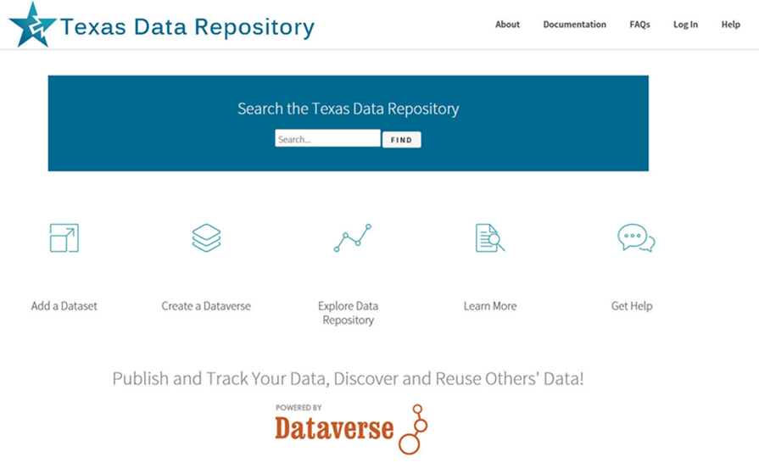
AI Requires: Processing Power (Microprocessor) + Data + Storage (Memory) + Global Networks
2014-2017, Texas Data Research Repository, Data Sharing, Collaboration, Data Visualization, Tableau, Discovery and Insights, Artificial Intelligence

Slide 6
Dataverse Data Research Repository Metadata
Dermatology Image Dataset, Dr. Philip Tschandl, Viennesse Dermatologist
Great Example of Open Science & Metadata
https://dataverse.harvard.edu/dataset.xhtml?persistentId=doi:10.7910/DVN/DBW86T

Slide 7
Open Science, Data Research Repositories, Discovery, Reuse and AI
Dermatologist-level Classification of Skin Cancer with Deep Neural Networks, Nature 2017,Andre Esteva, Brett Kupress, Sebastian Thrun et al. Labeled Medical Data from Image Data Archives to Training AI Models (Deep Learning), Convolutional Neural Nets,
Video Stanford Overview

Slide 8
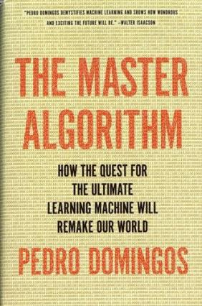
AI Has Many Paradigms and Origins Algorithms, Suitable Problem and Solution Methods, Dr. Pedro Domingos, University of Washington
AI Paradigm | Origin | Algorithm | Problem | Solution
Deep Learning Machine Learning | Neuroscience (Neural Nets) | Back Propagation Neural Nets | Complex Tasks, Hidden Patterns | Back propagation
Symbolic AI | Logic, Philosophy | Inverse Deduction | Knowledge Composition | Inverse Deduction
Bayesian Inference | Statistics, Probability Theory | Probabilistic Inference | Uncertainty | Probabilistic Inference
Evolutionary Computation | Evolutionary Biology (Complexity Theory | Genetic Algorithms | Structure Discovery | Genetic Programming
Reasoning by Analogy | Psychology | Kernel Machines (Support Vector Machines) | Similarity | Kernel Machines
2015, 2018

Slide 9
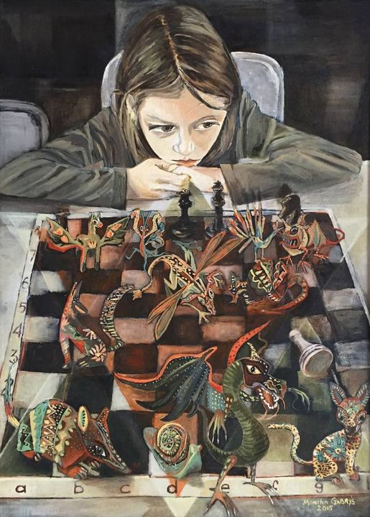
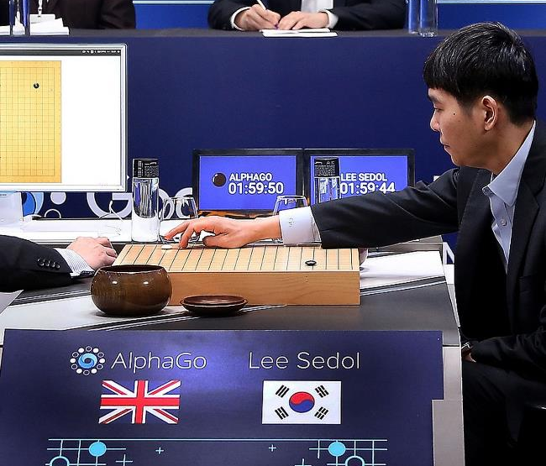
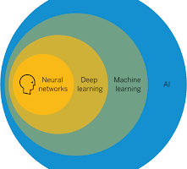
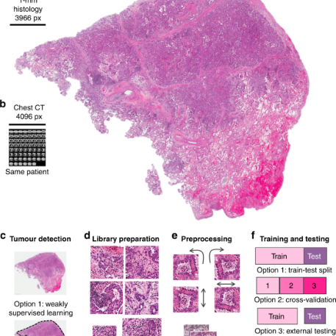
Last Ten Years 2014-2024 Amazing Progress of AI AI (Machine Learning (Deep Learning)) = Better Algorithms + Greater Computing Power + Large Data Sets + Good Metadata (Labeling)
GPT’s, Conversational Chatbots & Robotic Agents
Natural Language Processing (Speech to Text, Next Word Translation)
Computer Vision Cancer Cell Detection(Alexnet) (Facial + Object Recognition
Strategic Reasoning (AlphaGo, 2015-2017)
Fraud Detection & Cybersecurity

Slide 10
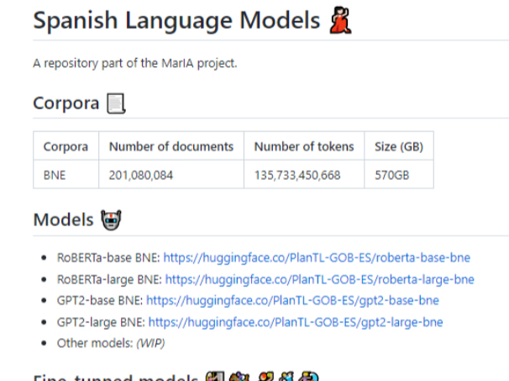
AI, Large Language Models (LLM’s) and GPT’s Generative Pretrained Transformers, January 2022, Trends and Issues In Library Technology
Digital Transformation, Data Reuse and Heritage Collections At the National Library of Spain, Supercomputing Center Partnership, Mare Nostrum, June 2022

Slide 11
Olympus (Amazon) Ernie (Baidu Search Engine)
Dr. Alan Thompson
GPT-4’s Mixture of Experts Model (MoE model) is believed to house 16 expert models, each with around 111 billion parameters each. The Mixture of Experts (MoE) is offering a unique approach to efficiently scaling models while maintaining, or even improving, their performance. Traditionally, the trade-off in model training has been between size and computational resources

Slide 12
Large Language Models (LLM’s) GPT1, GPT2, GPT3, GPT3.5 and GPT4 GPT – Generative Pretrained Transformers
Characteristics
GPT-4 Model: Advanced AI language model, 175 trillion parameters.
Mixture of Experts (MoE): Architecture using specialized networks for varied tasks.
Parameters Defined: Components in the model learned and adjusted from data. Used for next word prediction/understanding
Training Data: Diverse textual sources, books, web content, language styles and information
Number of Tokens: Trillions of text pieces, words, or characters.
Adaptive Learning: Appears contextually responsive, but doesn't learn post-training.
Task Versatility: Handles translation, answering, summarization, and creative tasks.
Ethical Considerations : Trained on addressing bias and misuse Searchunify.com

Slide 13
ChatGPT 3.5 and ChatGPT 4.0 on several well recognized Human intelligence tests Visualcapitalist.com

Slide 14
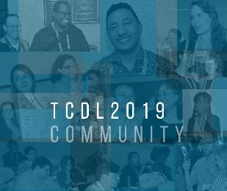
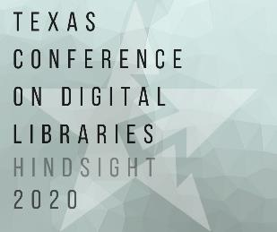
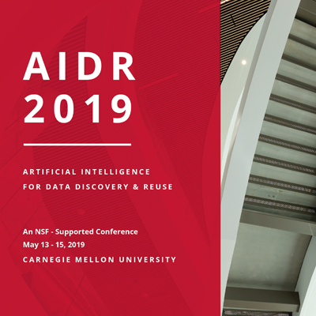
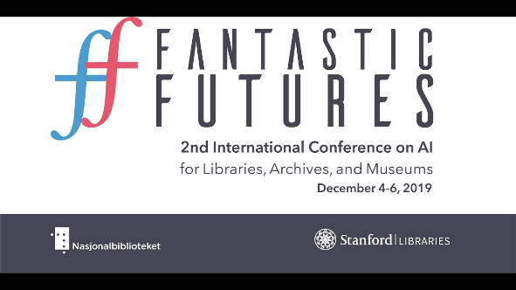
R&D, Academic Technology Conferences and Learning, 2018-2022
Coalition for Networked Information (D.C.) , Yale Art History Project ,Pixplot (Image Categorization), 2018, Peter Leonard (Neural Nets) Artificial Intelligence for Data Discovery & ReUse & Open Science Symposium (2020), Carnegie Mellon, Pittsburgh Fantastic Futures
2nd International Conference on AI for Libraries, Archives and Museums Stanford Libaries (2019) Texas Conference on Digital Libraries, Patrice Andre Prud’homme (TCDL) Oklahoma State (2019),

Slide 15
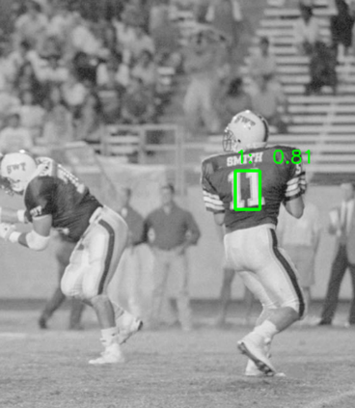
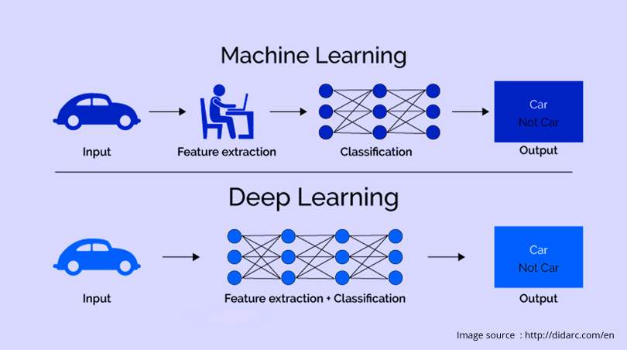
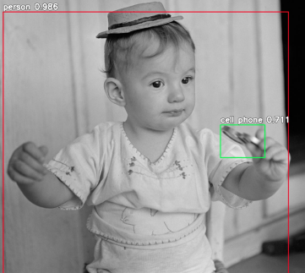
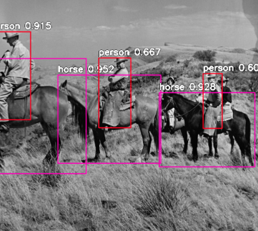
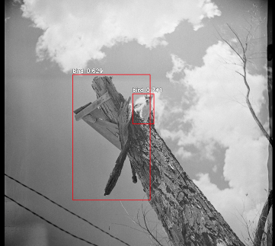
R&D & Learning, Area 1: Digital and Web Services Deep Learning Models and Convolutional Neural Nets (2019 Begun, Early 2022 Presented, TCDL, Galway, National University of Ireland, IFLA Dublin, IR)
University Archives San Marcos Public Newspaper Image Negatives 90 years of digitization 800, 000 images
Processing Power (Compute)
Python
Video Cards (NVIDIA GPU’s)
Pretrained Models
ResNet, YOLO, COCO (200k labeled images, 80 categories)

Slide 16
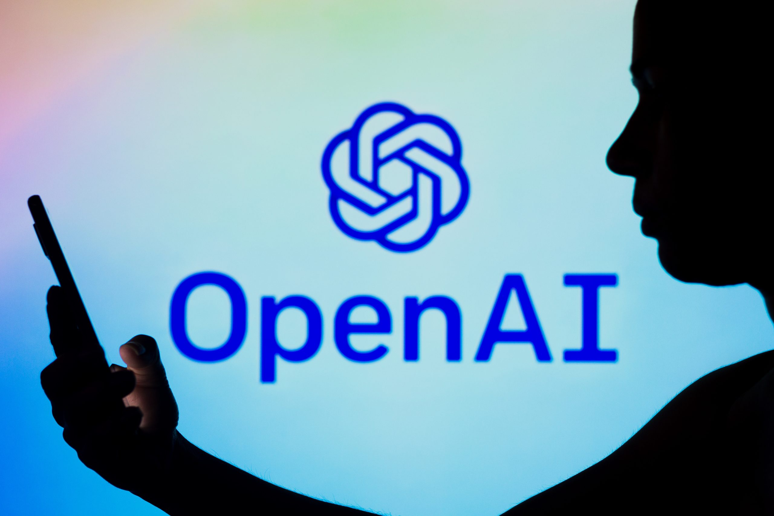
Open AI, November 2022, Chat GPT3.5 Release Chatbot version of the Language Model GPT3, Current Release GPT4.0
Generates Human-like Text: Writes and chats naturally. Next word model extended. Probabilistic Language Model
Based on Transformer Model + Neural Nets: Efficient, smart text processing. Trained on over 175 Billion Parameter (massive learning capacity)
Uses Attention Mechanism: Focuses on relevant information. and Transformers (Query, Key(words), Value model)
Trained on Massive Amount Text and Can Perform multiple tasks: Understands massive amount of topics to Answer questions translate, create (synthesize new knowledge)
Makes Predictions: Infers answers from data, language, words
Context-Aware Responses: Understands conversation history.
Handles Complex Instructions: Understands nuanced requests.
Availability: Through Bing (Microsoft, Free) and OpenAI (Paid, 20.00/month, Android/Apple (App Download)
Sam Altman, CEO, Ilya Sutskever, Chief Scientist, Satya Nadella, Microsoft CEO, Greg Brockman, President Main other Competing Models Gemini Pro/Ultra (2024) Claude 2 Anthropic Mixtral

Slide 17
Massive Multitask Language Understanding Test, (57 Tasks) from Math to Law and Computer Science

Slide 18
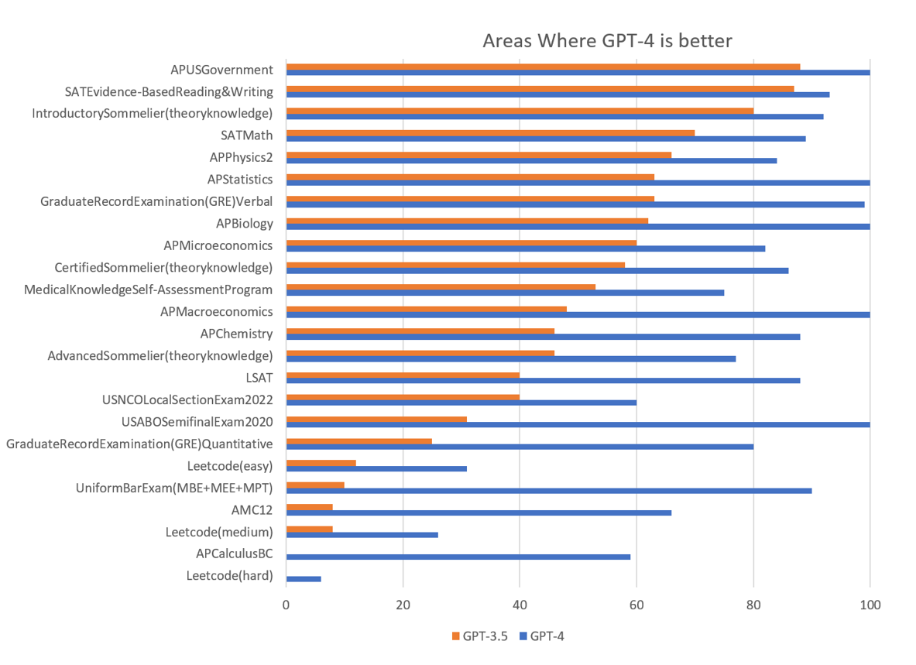
How Intelligent is GPT 4? Standardized High School and University Tests (GPT3.5 & GPT4.0 Humans vs. Artificial Intelligence
90%
85%
100%
100%
85%
80%

Slide 19
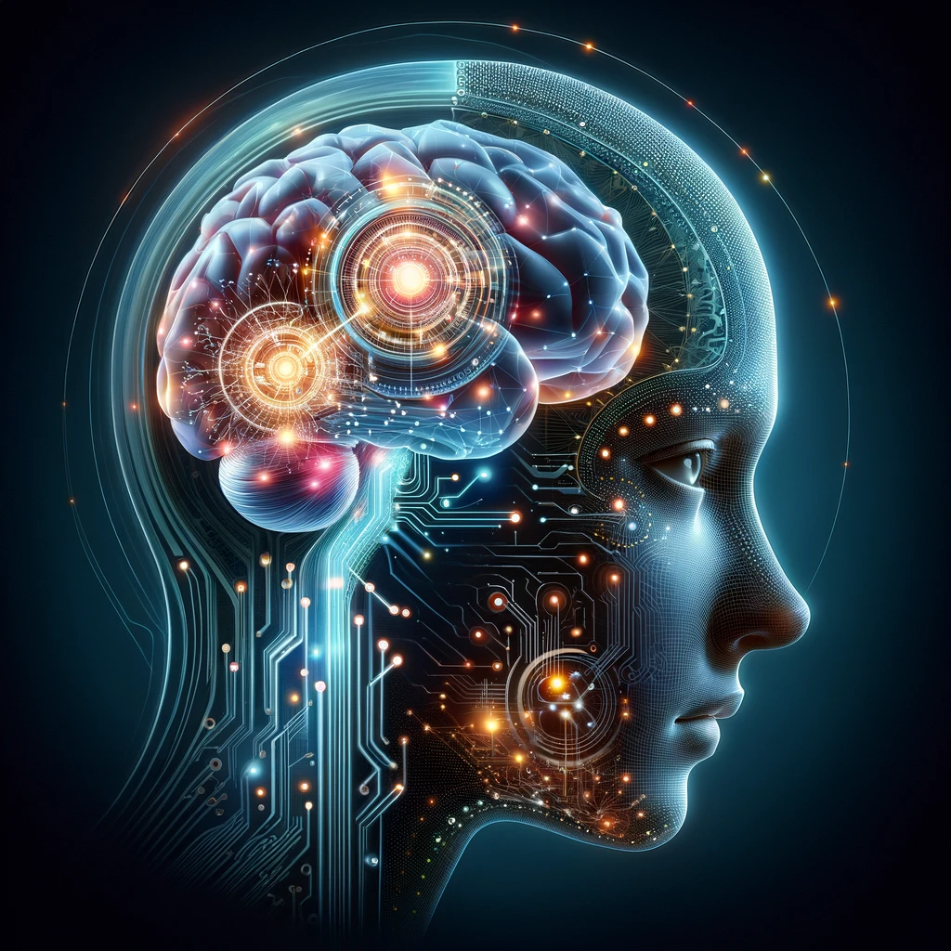
ChatGPT AI Use Case Scenarios Shift in Knowledge Seeking from Search Engine Search to Direct Answers and Outcomes
General Knowledge Seeking, Language Translation, Knowledge Synthesis
Business: Business Development, Marketing, Analysis, Decision Making, Customer Support/Service, Troubleshooting, Business Plans
Education and Learning: Tutoring, language learning, homework, K-12, Undergraduates and Graduates
Content Creation: Articles, stories, administrative help and documents, creative ideas, poetry, scripts
Data Analysis: Summarization, analyzing data, generating reports, business analysis Wellness and Mental Health: empathetic and professional responses Personal Assistant: Managing Schedules, organizing reminders

Slide 20
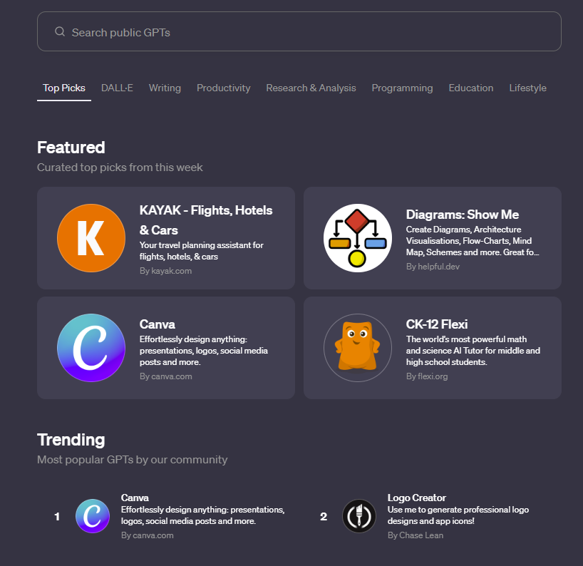
Open AI’s GPT Store Memberships but Apps are free
Featured and Trending Dalle (Multimodal Based) Writing Related Research and Analysis Programming Education Video Making, Marketing Related

Slide 21
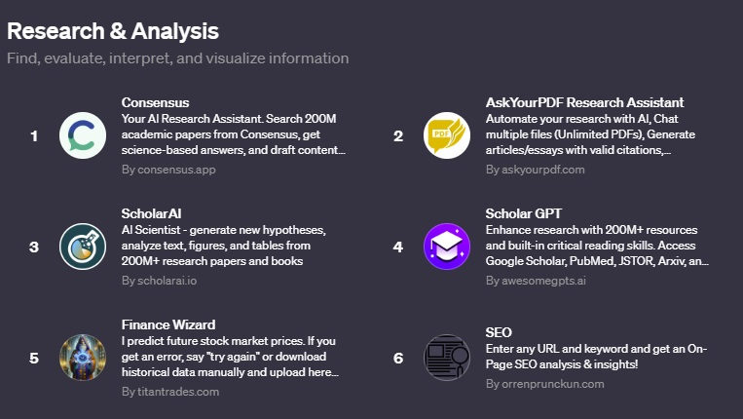
Research & Analysis GPT 4.0

Slide 22
Education, GPT 4.0

Slide 23
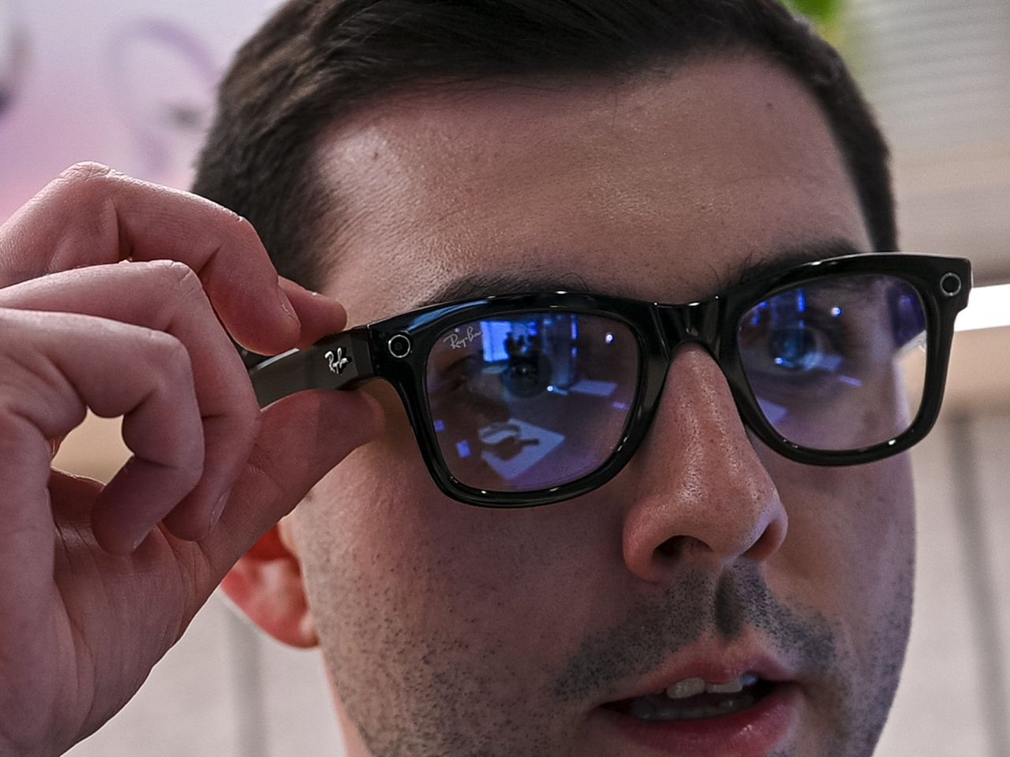
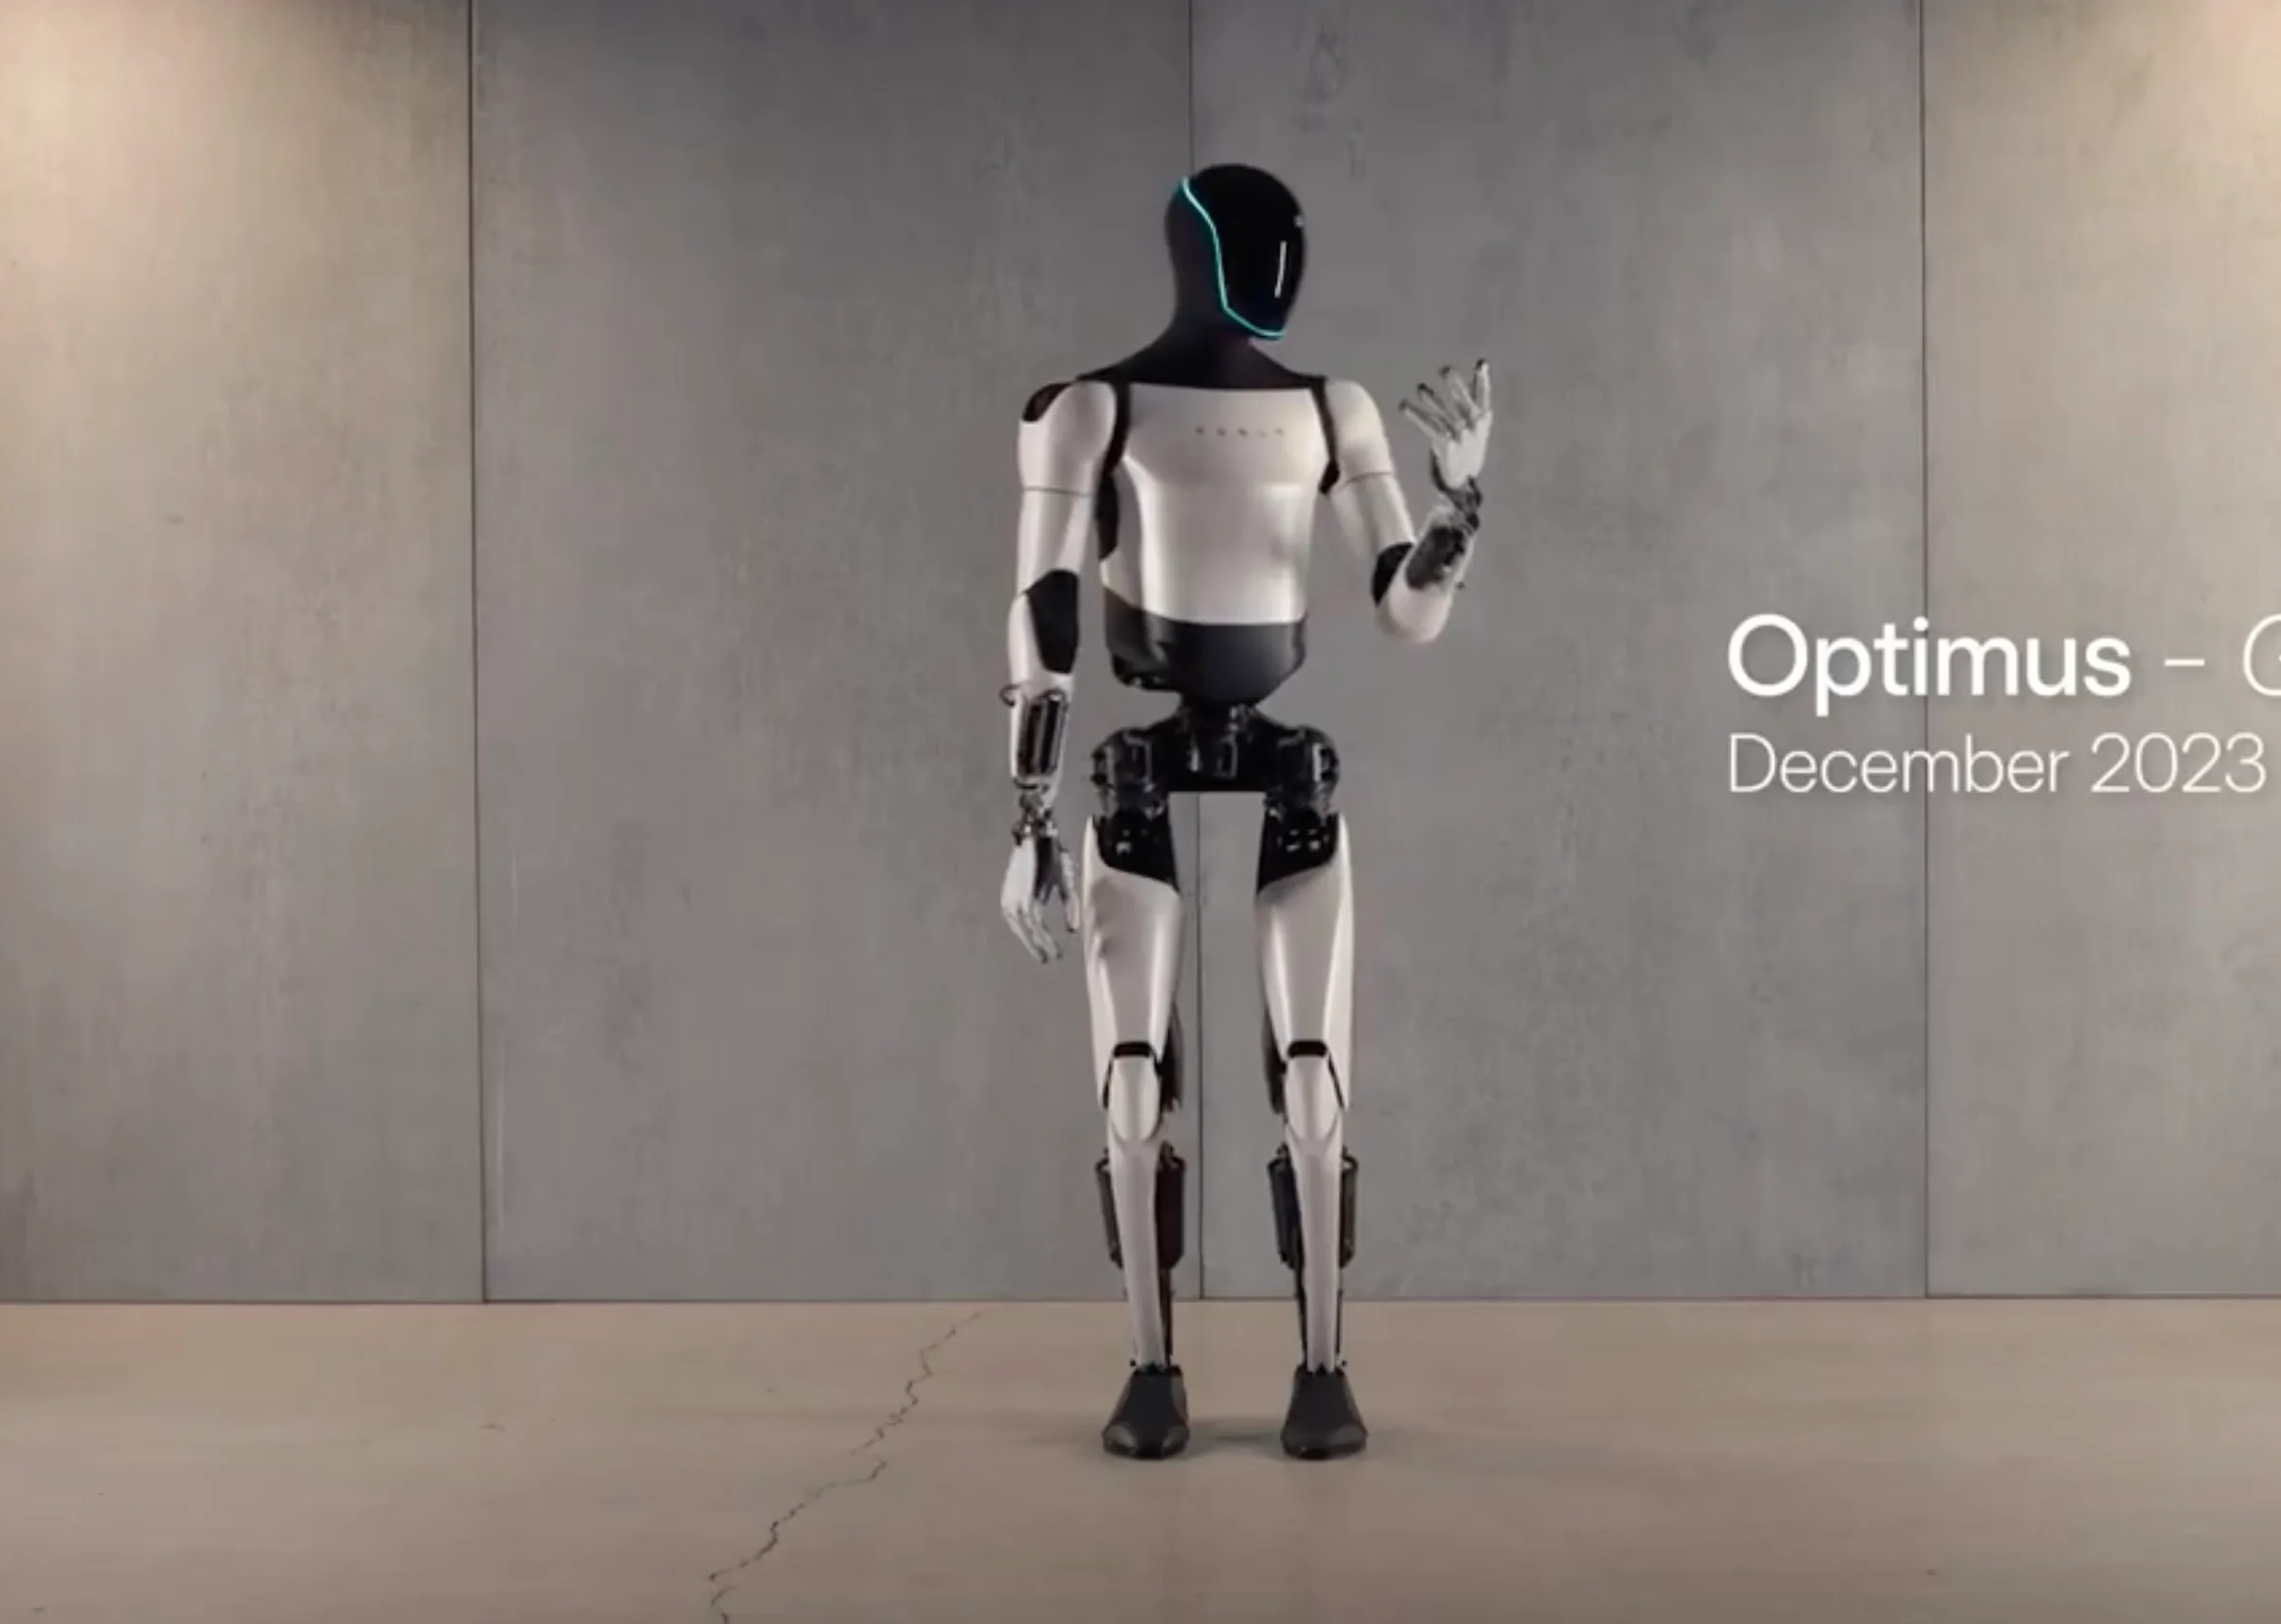
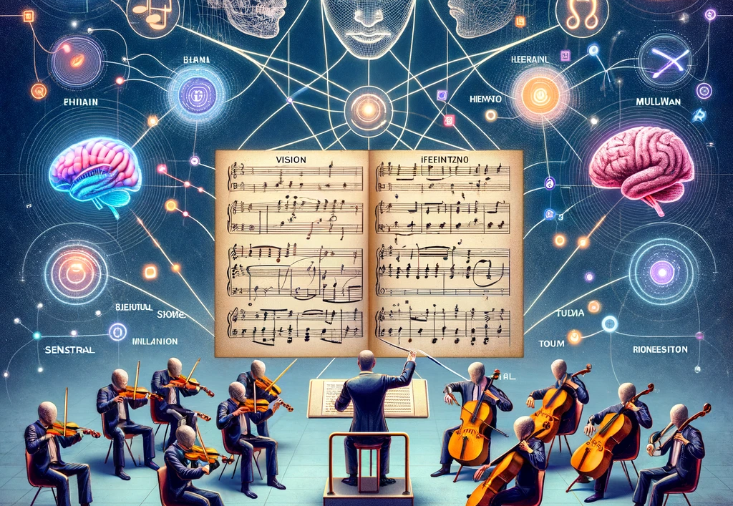
Multimodal AI, GPT4 + Image/Voice/Audio-visual and Force Feedback Models (Robotics), 2024+
Image Generators Dalle-3, Midjourney Stable Diffusion Text to Image and Image to Video Models
Video Generators: Runway, PIKA, Stable Diffusion Video, Lumiere, Image to Video, Text to Video, Video to Video
Device Integration & Robots: Optimus (Tesla Bot), Boston Dynamics, NVIDIA, Meta’s Rayban Glasses AI + XR Smart Phone Integration
Use Case Scenarios: Powerpoint to Essay, Natural Human Instructions: No code movement, PDF to Image Augmenting the Senses: XR (Extended Mixed Media Reality + AI Artificial Intelligence

Slide 24
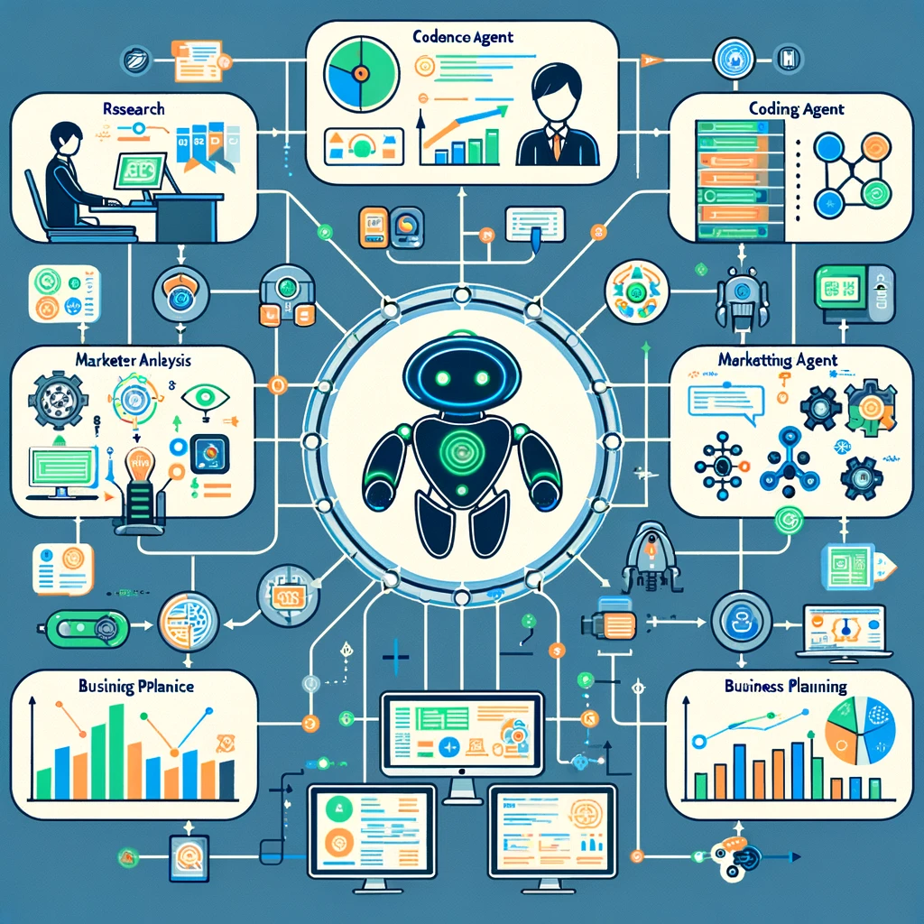
Autonomous Agents 2024 Linked AI’s working together
Autonomous agents are AI systems or entities that operate independently to perform tasks or make decisions
Autonomy: Operates independently without human intervention.
Adaptability: Learns and adapts to new environments and experiences.
Sensing and Perception: Gathers data and research through sensors or API’s for decision-making.
Goal-Oriented: Designed to achieve specific objectives or tasks.
Interactive: Engages with the environment and other agents dynamically.
Examples Autogen, Agent GPT, OpenAI GPT Store List: https://toplist-central.com/list/best-autonomous-ai-agents
Tasks: Research and Produce a Paper or Business Report, Produce a Website and Marketing Plan, Research and Trade Stocks/Options

Slide 25
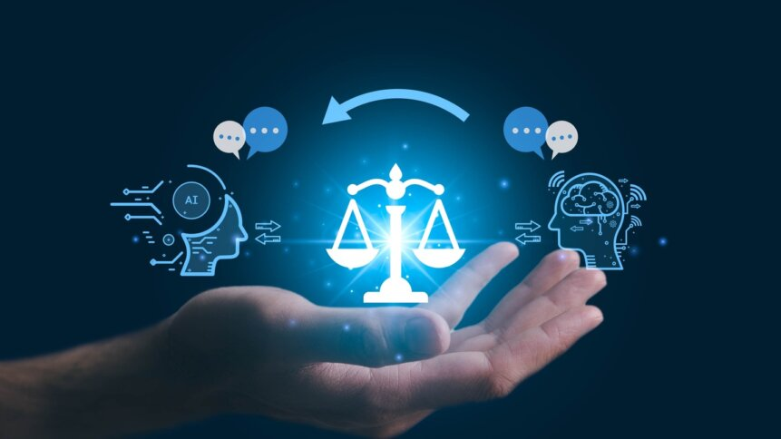
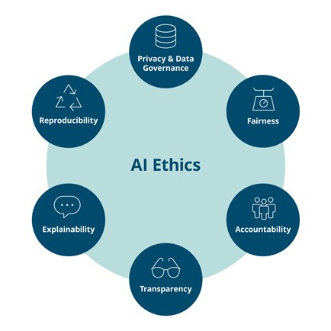
AI Ethics, Safety, Alignment, Accuracy and Precision
AI Hallucination (False Comments, Made up Results)
Bias and Data (Began 2017)
Neural Nets and Complexity
Ethics and Censorship
Ethics and Law
Alignment: Alignment with Human Values
Deep Fakes and Elections, Manipulation, Propaganda, Information Literacy
Constitution (Anthropic)
New Horizons for AI in Libraries (De Gruyter)

Slide 26
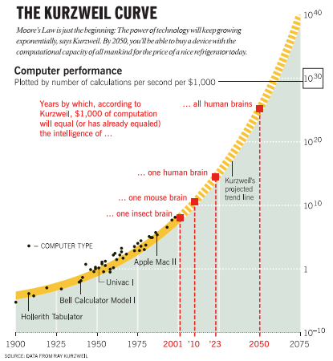
AI, Artificial General Intelligence AGI and ASI (Artificial Superintelligence)
AGI (Artificial General Intelligence): A form of AI that equals average human intelligence, capable of performing any intellectual task that a human being can.
ASI (Artificial Super Intelligence): An AI that surpasses human intelligence across all areas, including creativity, general wisdom, and problem-solving.

Slide 27
Select Bibliography, Further Sources, February 2024
Language Models
GPT 4: Open AI (Dalle-3, Multimodal, GPT Store, 20.00$)
Gemini Ultra (2024)
Mixtral (More Technical Knowledge Needed, Open Source)
Microsoft Copilot (GPT4, Dalle, Free, Limited Horizons on Knowledge)
Image and Video Generators
Dalle-3 (Open AI), Midjourney PIKA Labs, Runway Lumiere (2024)
Autonomous Agents Top Lists Top 5 Top 11 AI Websites and Youtube AI News Wes Roth: General AI News MattVidPro AI: Uninversity Millenial Perspectives Mattew Berman: Programming and AI The AI Grid (Good British AI News Site, Ph.D. Candidate) Academic ResearchGate, Dr Raymond Uzwyshyn, Papers, Presentations, Projects Dr. Alan Thompson: Human/AI Benchmarking Two Minute Papers, Dr. Karoly Zsolnai-Feher
Presentation https://www.researchgate.net/profile/Raymond-Uzwyshyn/research

Slide 28
Questions and Comments?

Slide 29
Marshall McLuhan: Extensions of Man

